Slide 1

Democracy, Justice, and AI AWARE-AI NRT
Irina Mikhalevich, Ph.D.
imgsh@rit.edu
Department of Philosophy
Rochester Institute of Technology
This Photo by Unknown Author is licensed under CC BY-ND

Slide 2


Outline of workshop
Introductions & pre-workshop writing exercise
Brief introduction to AI ethics
Break
Democratizing AI mini-lecture & discussion
Break
AGI & Democratic participation mini-lecture & discussion
This Photo by Unknown Author is licensed under CC BY-SA-NC
This Photo by Unknown Author is licensed under CC BY-NC-ND

Slide 3
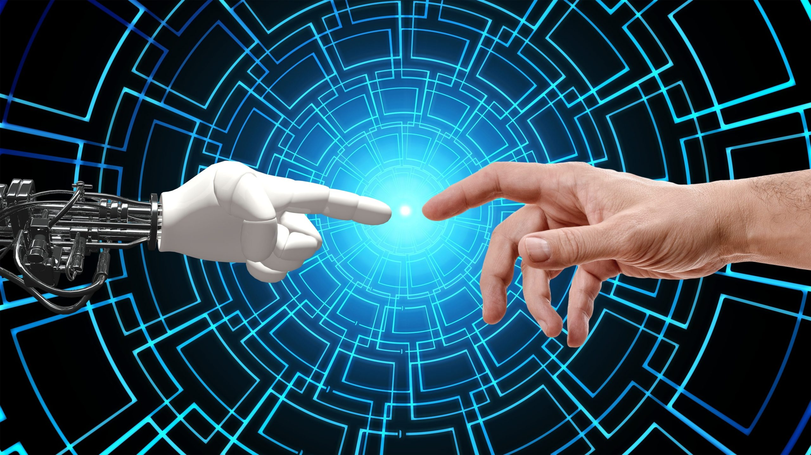
1. Introductions: What is AI ethics to you?
In your view, what is the single most pressing moral issue facing AI today? (10 minute roundtable discussion)
This Photo by Unknown Author is licensed under CC BY-NC

Slide 4

2. Very Brief Introduction to AI Ethics
A broad overview and summary of one framework for ethical AI
This Photo by Unknown Author is licensed under CC BY-NC-ND

Slide 5
AI Ethics as a discipline
Ethics is the study of morality.
Applied ethics is the study of morality within specific domains of life (e.g., biology, medicine, animal rights, technology, etc.)
AI Ethics is a branch of applied ethics and intersects with
political philosophy, STS, cognitive science, computing, etc..

Slide 6
What morality is … and is not
The Minimum Conception of Morality: Morality is normative, reason-responsive, impartial, and universal (Rachells 1998).
Contrast with “thick” conceptions of morality – utilitarianism, Kantian deontology, etc.
Sources of Normativity outside of Morality:
The law
Cultural norms
Religion

Slide 7

What do we mean by Artificial Intelligence?
Strong AI (~AGI) versus Weak AI (Searle 1989)
Strong AI & Artificial General Intelligence (AGI): Artificial minds
AGI: understanding/semantics V mere syntax
Strong AI (Searle): AGI + consciousness
Weak AI: every other form of AI and machine learning
Ethical implications of the distinction
IF strong AI/AGI → we may have moral obligations toward the AIs themselves (including, perhaps, to involve them in democratic decision-making).
IF weak AI → presumably no obligations toward them. Instead, our obligations will be toward those moral patients and moral agents who would be impacted by the AI (present and future individuals or groups, the planet, etc.). Appropriate analysis would focus on threat-assessment and benefit estimates of AI vis-à-vis valuable social institutions.
This Photo by Unknown Author is licensed under CC BY-SA-NC

Slide 8
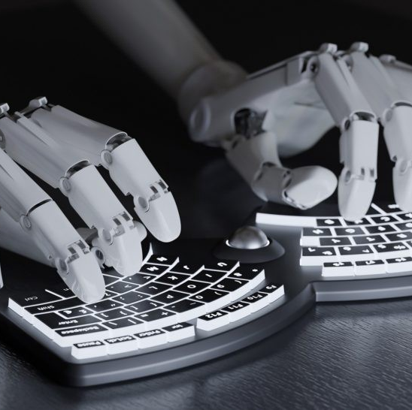
Ethics of “weak” AI
Assessments of the projected risks, benefits, and opportunity costs associated with decisions to invest in, develop, bring to market, and regulate AI technologies must include the moral risks, benefits, opportunity costs.
Who are the stakeholders and with whom do the moral responsibilities lie?
This Photo by Unknown Author is licensed under CC BY

Slide 9
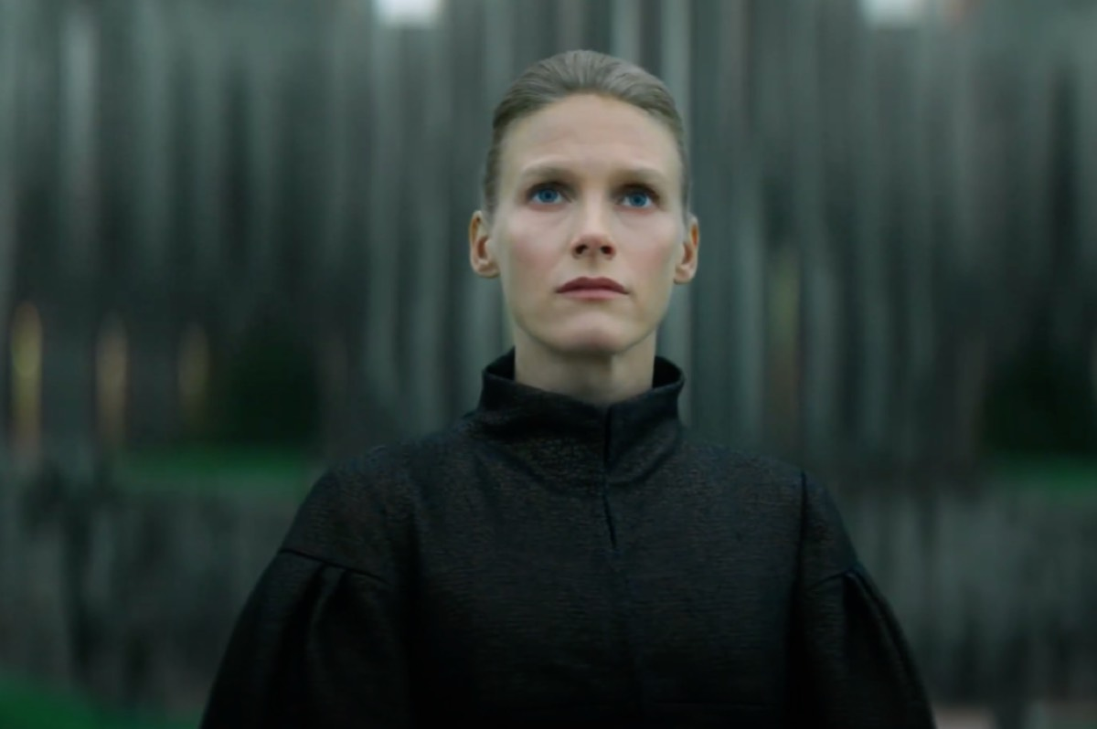
Ethics of Strong AI/AGI
Moral status of S-AI/AGI
A non-exhaustive list of questions:
What would it take for an AGI/S-AI to be a moral agent? A moral patient?
If AGI/SAI have moral standing, what is their moral status relative to human beings?
Are we morally permitted to develop strong AI and, if so, with what constraints?
How can we ensure that the social legal landscape is prepared for the emergence of strong AI?
May or ought we ensure that emerging AIs are themselves moral agents?
If AGIs have moral standing, would it limit their freedom to build ethical constraints into their programming? If so, is this a violation of their rights?

Slide 10
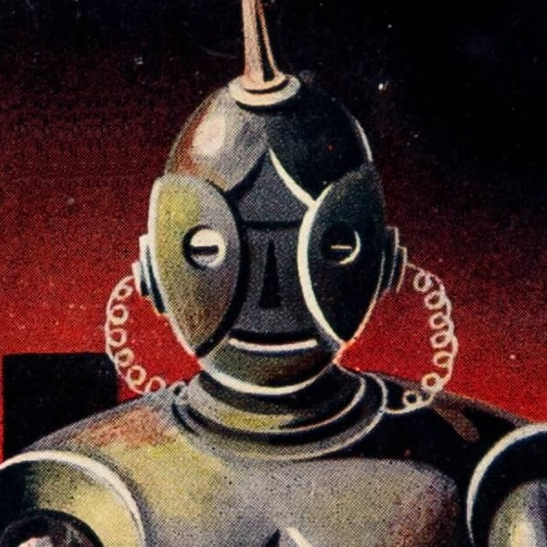
A proposed framework for ethical AI
Many proposals for ethical frameworks for the development, distribution, and regulation or AI
We’ll take a look at one: Floridi, Luciano, et al. "AI4People—An ethical framework for a good AI society: Opportunities, risks, principles, and recommendations." Minds and Machines 28.4 (2018): 689-707.
Rationale:
Synthesizes existing proposals for ethical AI,
incorporates these into established bioethical paradigm,
and offers concrete recommendations for inter-governmental groups (EU).
This Photo by Unknown Author is licensed under CC BY-SA

Slide 11
Floridi et al. (2018) propose the following ethical framing
Ethical AI should be formulated with a view to preserving human dignity & supporting human flourishing (Floridi et al., 690)
The guide toward these goals are the bioethical principles + 1 additional principle.

Slide 12
What are moral principles? Where do they come from? Why should we accept them?
Moral theory
Abstract guide for assessing right/wrong, good/bad
Revisable - seek reflective equilibrium between theory, intuitions, and considered moral judgments
Principles
Derived from theories and intuitions
Less abstract than theories, capable of guiding decision-making
Applications
of principle
to concrete cases
Guides action/decision-making
Probes intuition via case examples and thought experiments (e.g., trolley problem)
Four Bioethical Principles
Beneficence
Non-maleficence
Respect for autonomy
Justice

Slide 13

AI Ethics: Four Bioethical Principles + 1
Beneficence
Non-maleficence
Respect for autonomy
Justice
Explicability
This Photo by Unknown Author is licensed under CC BY-SA-NC

Slide 14

Beneficence
“Taken together, the prominence of these principles of beneficence firmly underlines the central importance of promoting the well-being of people and the planet.” (Floridi et al., 697).
This Photo by Unknown Author is licensed under CC BY
Notes:
Examples:

Slide 15

Non-maleficence
Prevent harm either “from the intent of humans or the or the unpredicted behavior of machines” (697)
Potential concerns include:
infringements on privacy
“privacy is characterised as being intimately linked to individuals’ access to, and control over, how personal data is used.” (Floridi et al., 697)
Ex: facial recognition technologies & government surveillance; Evan Selinger: the right to anonymity
Ensuring “upper limits of future to AI capabilities” (caution against recursive self-improvements)
Spread of misinformation, disinformation
Create or support social division, polarization, extremism, & stochastic violence
This Photo by Unknown Author is licensed under CC BY-ND

Slide 16
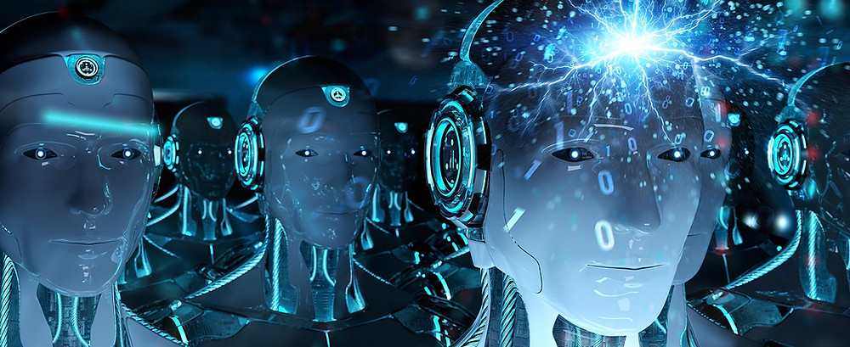
Autonomy
“Taken together, the central point is to protect the intrinsic value of human choice—at least for significant decisions—and, as a corollary, to contain the risk of delegating too much to machines.” (Floridi et al. 698).
Autonomy as the preservation of human freedom & constraints on the freedom of AIs
Emphasis on meta-autonomy/the decision about when to delegate.
Note: Isaiah Berlin’s two senses of “freedom”: Freedom to (positive freedom) and Freedom from (negative freedom)
Note: If Strong AI is possible, then we may have a tension between non-maleficence & respect for the AI’s autonomy.
Can AIs shape our preferences and desires in unpredictable ways (e.g., through nudging), thus altering who we are in ways that diminish our freedom?
Notes:
Autonomy as the preservation of human freedom & constraints on the freedom of AIs
Floridi et al. om autonomy: “the idea that individuals have a right to make decisions about the treatment they do or do not receive”
“Therefore, what seems most important here is what we might call “meta-autonomy”, or a “decide-todelegate” model: humans should always retain the power to decide which decisions to take, exercising the freedom to choose where necessary, and ceding it in cases where overriding reasons, such as efficacy, may outweigh the loss of control over decision-making. As anticipated, any delegation should remain overridable in principle
(deciding to decide again).”

Slide 17
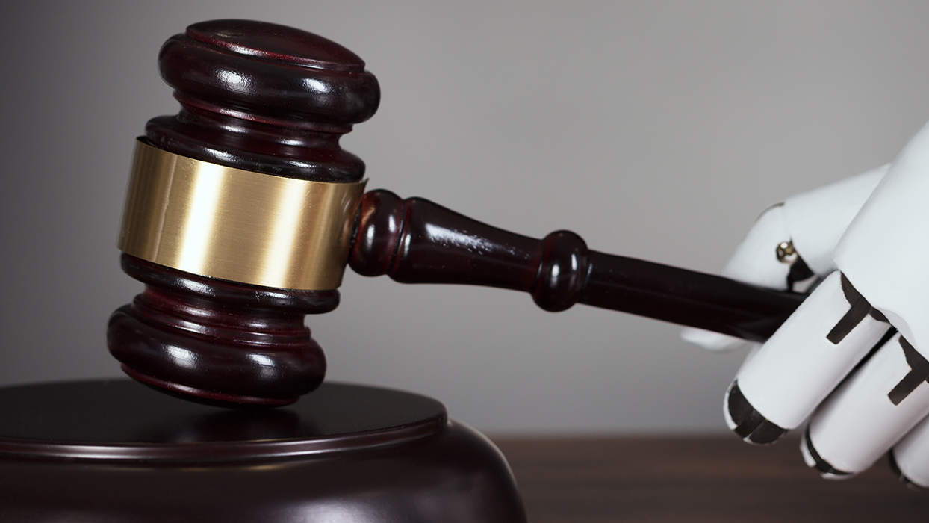
Justice
“Across the documents, justice variously relates to:
(a) Using AI to correct past wrongs such as eliminating unfair discrimination;
(b) Ensuring that the use of AI creates benefits that are shared (or at least shareable);
and
(c) Preventing the creation of new harms, such as the undermining of existing social structures.”
Question: can we map these concerns onto different conceptions of justice (e.g., distributive, procedural, corrective, etc.)?
Question: Are there other kinds of justice concerns that are not named here, such as ensuring the integrity of institutions entrusted with delivering justice?
This Photo by Unknown Author is licensed under CC BY-ND
Notes:
A problem emerges: how do we resolve the confusion about where to locate agency (in the AI or in us)?

Slide 18
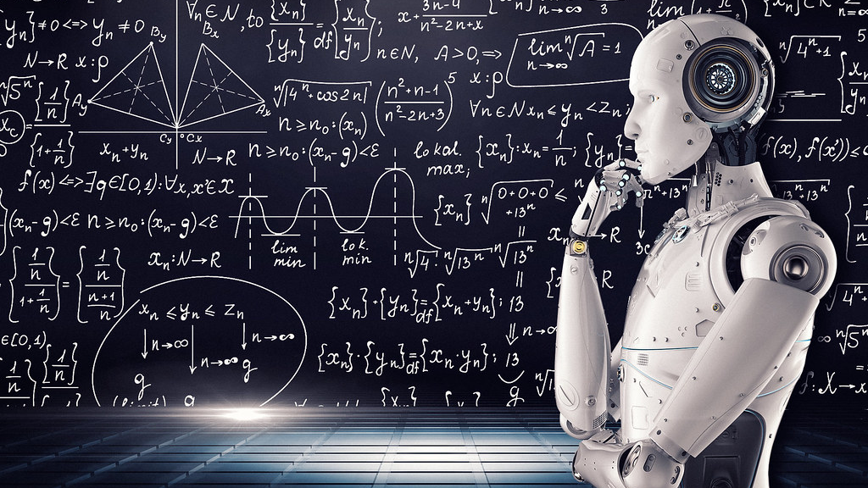
Explicability
“The situation is inherently unequal: a small fraction of humanity is currently engaged in the design and development of a set of technologies that are already transforming the everyday lives of just about everyone else.” (Floridi et al. 2018, 699)
Two dimensions of explicability
Intelligibility (epistemological dimension)
Accountability (ethical dimension)
Explicability and other bioethical principles
How does explicability augment autonomy?
How does explicability augment non-maleficence?
How does explicability augment beneficence?
How does explicability augment justice?
This Photo by Unknown Author is licensed under CC BY

Slide 19

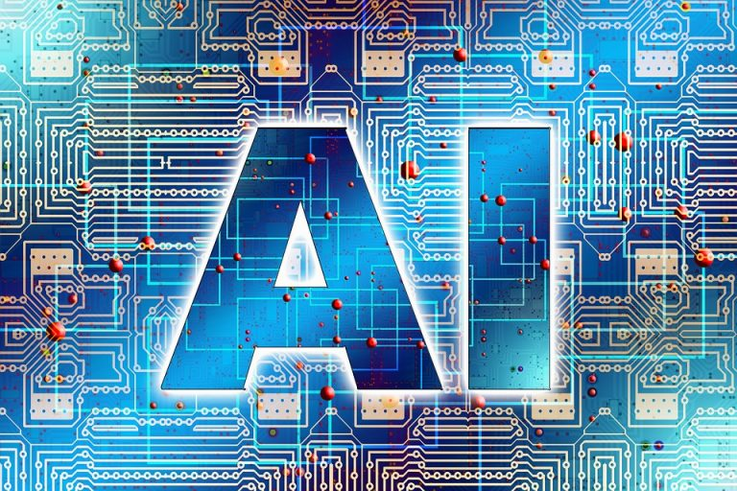
Summary of Recommended Actions at the level of international bodies (EU)
Four action points:
Assessment
Development
Incentivization
Support
This Photo by Unknown Author is licensed under CC BY
This Photo by Unknown Author is licensed under CC BY-ND

Slide 20
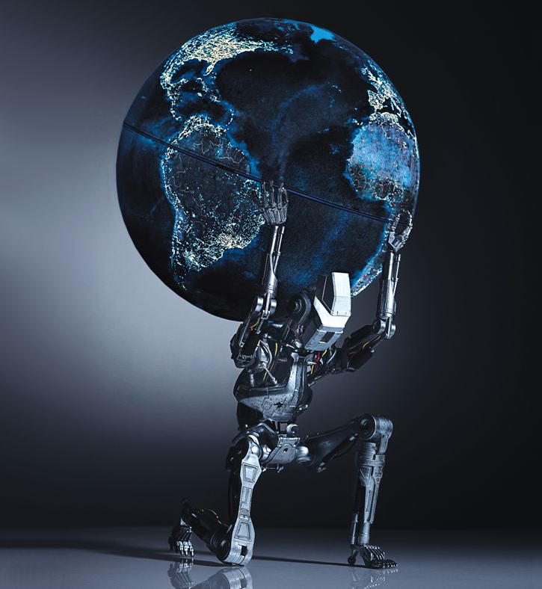
Summing Up
Motivations for ethical AI: opportunities for human dignity & flourishing
Guide should be: five ethical principles.
Proposal: Structuring future AI assessment, development, incentivization, and support at the level of nations and multinational organizations, such as the EU with an eye to the five principles.
This Photo by Unknown Author is licensed under CC BY
Notes:
The answer

Slide 21
3-minute exercises
Can you reframe the concerns with which we started out this session in terms of the five bioethical principles and their relationship to human dignity and human flourishing?
What, if anything, might human dignity and human flourishing have to do with democracy?

Slide 22

10 minute BREAK

Slide 23
AI and Democracy
4. Democratizing AI mini-lecture and discussion
5. Break
6. AI and Democratic Participation mini-lecture and discussion
This Photo by Unknown Author is licensed under CC BY-NC

Slide 24
There is no question that artificial intelligence (AI) is rapidly evolving and growing more sophisticated every day. With this in mind, it is natural to wonder how AI will impact democracy.
There are many potential implications of AI on democracy, both positive and negative. On the positive side, AI could help to improve the efficiency of democratic institutions and processes. For example, AI could be used to streamline the process of voter registration or to help keep track of election results. AI could also be used to help identify and track public opinion on various issues. On the negative side, AI could also be used to manipulate public opinion or to interfere with democratic processes. For example, AI could be used to spread false information or to target individuals with personalized messages designed to sway their opinions. AI could also be used to hack into election systems and tamper with the results.
Overall, it is difficult to predict exactly how AI will impact democracy. However, it is clear that AI will likely have both positive and negative implications for democracy. It is important to keep a close eye on how AI develops and to be aware of the potential risks and challenges that it poses to democracy.
- GPT-3

Slide 25
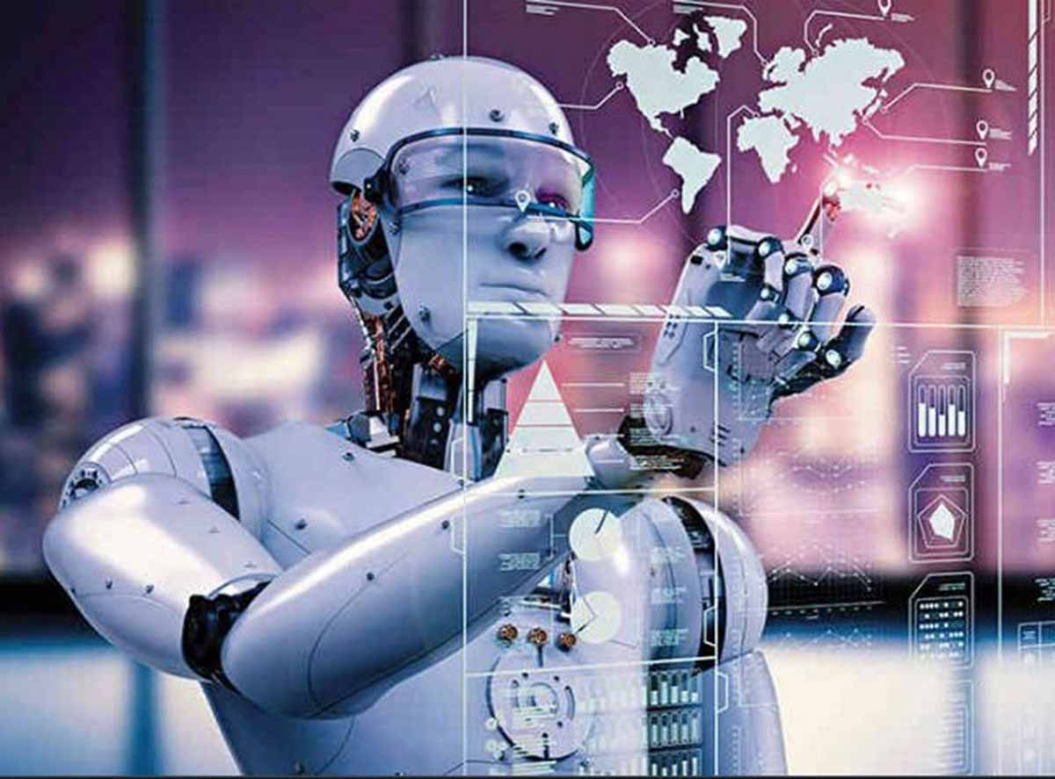
Strong AI/AGI & Democracy
Do S-AIs or AGIs have a right to participate in political processes & democratic self-governance?
Do AGIs threaten democratic institutions or processes? If so, how might their interests we weighted against human rights?
(More on this shortly)

Slide 26
(Weak) AI and Democracy 1/2
What is the impact of AI on democratic institutions?
Should AI itself be democratized?
Do “explicability” and accountability require democratization?
Normative/ethical question: Is democratization of AI desirable?
Practical Question: What would this look like in practice?

Slide 27
(Weak) AI and Democracy 2/2
What is the value of democratic institutions?
Autonomy: democratic processes aim at self-governance & freedom for citizens
Justice: democratic processes aim at fair distribution of social benefits and burdens (fairness may be an outcome of or secured by democratic deliberation)
Stability: if participatory democracies are fairer, and if fairness promotes stability, then democratic societies should be more stable than alternative arrangements (all else being equal).
How can AIs impact democratic institutions?
Democracy depends on free and informed citizens. AI in journalism, social media engagement algorithms, algorithms behind search-engine recommendation, etc., shape the information space and have the power to create division or cohesion, to promote or suppress pro-democracy activism (e.g., YouTube radicalization, Facebook and violent extremism), and more
AI integrated into democratic decision-making processes may call into question the legitimacy of democratic institutions (Beckman et al, 2022)
AI arms race with authoritarian nations with different views of (e.g.) human dignity (and thus privacy, freedom of speech and assembly, etc.)
The threat of autonomous AIs (The “Superintelligence” scenario)
Beckman et al. 2022. “Artificial intelligence and democratic legitimacy. The problem of publicity in public authority” AI ad Society

Slide 28

4. Democratizing AI: mini-lecture

Slide 29
What might it mean to democratize AI?
To make AI technologies broadly available and accessible to everyone or give everyone the resources to use/develop AI tech for themselves
To ensure that AI technologies are governed democratically.

Slide 30
Reasons to “democratize” AI
“…the fundamental democratic norm where all decisions (say of parliament or public officials) are documented and open to inspection by citizens at a later time. Similarly, this would be translated to public sector AI systems, and more generally, any technology or AI system that claims to be in the public interest. It speaks to the idea that democratic civil societies not only have the right to understand the workings of technology (which requires transparency and explainability) but also be able to validate its mechanisms to be democratic if they are claimed to serve the public interest.”(Züger & Asghari 2022, emphasis added)
“AI for the public. How public interest theory shifts the discourse on AI” (Züger & Asghari 2022)

Slide 31
Reasons to democratize AI continued
Rationale 1: AI democratization as an extension of democratic principles of self-governance by the people. Insofar as AI is both a public good and a constitutive element of collective democratic practices, it should be under popular control.
“… democratic civil societies not only have the right to understand the workings of technology (which requires transparency and explainability) but also be able to validate its mechanisms to be democratic if they are claimed to serve the public interest.”(Züger & Asghari 2022; emphasis added)
Rationale 2: Democratizing AI is a strategy for addressing existing injustices (e.g., in policing, education, etc.) and ensuring other moral goods, such as equality, fairness, and freedom.
“AI for the public. How public interest theory shifts the discourse on AI” (Züger & Asghari 2022)

Slide 32
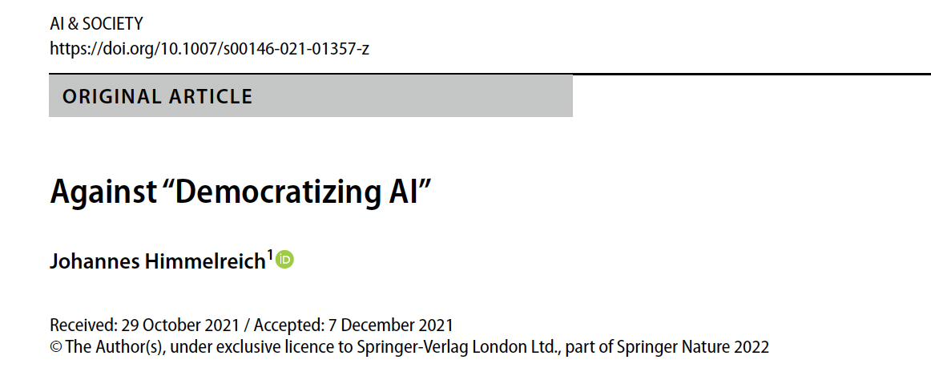
Limitations of the standard approaches to AI democratization
“Against Democratizing AI” (Himmelreich 2021):“Democracy is a system of social governance that gives everyone a fair and equal opportunity of influence.”
Proposals to democratize AI typically construe democratization as broad and maximally inclusive “participation by the people.”
Too abstract – does not specify how participation should happen – and thus open to exploitation.
Language of democracy (broad participation by the people) has been co-opted by authoritarians, kleptocrats, and populists.

Slide 33
Limitations of the standard approaches to AI democratization
“Against Democratizing AI” (Himmelreich 2021):
Critiques standard calls for AI democratization + proposes that AI should be democratized not by aiming at increased participation simpliciter but by ”democratizing the administrative and executive components of our collective decision-making.”
Recommends asking 3 questions:
The democratization of what?
Why should AI be democratized?
How should AI be democratized?
Notes:
The upshot of this paper may sound anti-democratic. It is not. I take myself to be playing for the same team as those
who demand to democratize AI—team democracy. I am worried about our game plan. The demand to democratize
AI seems to be driven by understanding “democracy” as “rule by the people.” Or at least, the demand emphasizes
the value and importance of broad and inclusive participation. Moreover, the demand is abstract. It concentrates on
the whether of participation not on the how. This abstract emphasis could be a fatal mistake. We see that authoritarian
figures misappropriate the idea of democracy to advance their kleptocratic or nationalist mission. These authoritarian
figures not only co-opt the name “democracy”, they also weaponize the idea’s substance (Mayer 2001).2 With the
gesture and solicitude of a tribune, authoritarians, claiming to be at one with the masses, take the “rule by the people”
element of democracy to turn democracy against itself. Our times therefore require that democratic theorists identify the
pitfalls and limits of participation. To clarify these limits is to defend democracy—both the ideal and the practice. This
paper is part of this effort.
… It is important to improve the democratic quality of the bureaucracy, that is, of the administrative and executive components of our collective decision-making.
Democratizing the administrative state—although not necessarily furthering participation—allows to overcome existing and future injustices—not only of AI.

Slide 34
Himmelreich’s 5 reasons against Democratizing AI
Weak grounds
Redundancy
Resource intensity
Popular oversights
Theoretical and practical inefficacy

Slide 35
Himmelreich’s 5 reasons against Democratizing AI 1/5
1. Weak grounds –AI systems are not the kinds of thing that need to be legitimized by being democratized, and democratization may exacerbate the very problems that it is meant to address.
“Whereas democracy might well be justified as the governance system of a state, and while it may contribute to justifying state authority, democracy might not be justified as a governance system beyond the state.”
2. Redundancy
3. Resource intensity
4. Popular oversights
5. Theoretical and practical inefficacy
Notes:
Whereas democracy might well be justified as the governance system of a state, and while it may contribute to justifying state authority, democracy might not be justified as a governance system beyond the state.

Slide 36
Himmelreich’s 5 reasons against Democratizing AI 1/5
1. Weak grounds
Triggers of legitimacy (apply to the state, but not strongly enough to AI):
Coercive powers – AI exists in already coercive environments; may contribute to existing coercive schemes, but not produce novel systems of coercion
Pervasive impact – AI contributes to systems that have pervasive impact, but does not create novel ones
Involvement in a scheme of social cooperation – “AI is embedded in existing systems of social coordination, but it does not constitute a system of social coordination.”
Democratization has costs (resource intensive, decisions by committee can lead to suboptimal outcomes and thus frustrate the aims of fairness)
2. Redundancy
3. Resource intensity
4. Popular oversights
5. Theoretical and practical inefficacy

Slide 37
Himmelreich’s 5 reasons against Democratizing AI 2/5
Weak grounds
Redundancy – “In domains, where the state governs legitimately through democratic institutions, no other institution ought to compete over practical authority.” Insofar as oversight/regulatory institutions already exist, novel ones are unnecessary.
Resource intensity
Popular oversights
Theoretical and practical inefficacy

Slide 38
Himmelreich’s 5 reasons against Democratizing AI 3/5
Weak grounds
Redundancy
Resource intensity – implementational challenges due to high demand for cognitive, financial, & temporal, resources of democracy—and especially direct democracy--can lead to democratization of AI being “infeasible, inefficient, or inequitable.” Compounding factor: the least advantaged may have the fewest of these recourses, so would be marginalized further. This leads to tension between participation & deliberation.
Popular oversights
Theoretical and practical inefficacy

Slide 39
Himmelreich’s 5 reasons against democratizing AI 4/5
Weak grounds
Redundancy
Resource intensity
Popular oversights – call to democratize AI emphasizes participation over deliberation. But, without systems to ensure that participation yields rational and unbiased collective decision-making, the process is susceptible to cognitive biases, motivated reasoning, groupishness, and may result in moral short-sightedness.
Theoretical and practical inefficacy

Slide 40
Himmelreich’s 5 reasons against Democratizing AI 5/5
Weak grounds
Redundancy
Resource intensity
Popular oversights
Theoretical and practical inefficacy – “A final reason against the call to democratize AI is not that there is something wrong with it, but that the call to democratize AI fails to speak to the concerns that animate it [injustice, oppression, etc.]” since “[d]emocracy is normatively thin.” “deliberative conception of democracy” is a step is preferable, but also insufficiently thick.

Slide 41
Conclusion
Rather than emphasizing popular participation – the broader and deeper the better – emphasis should be on shoring up democratic processes within existing governance structures.

Slide 42
Exercises
Take a minute to evaluate these objections to the standard picture.
Is there a practical dimension to the proposal that we make existing structures either more democratic or more responsive to the reasons/causes that animate the call for democratizing AI?
What might your role be in evaluating or implementing these recommendations? As AI researchers, developers, citizens, etc?

Slide 43
5 minute BREAK

Slide 44
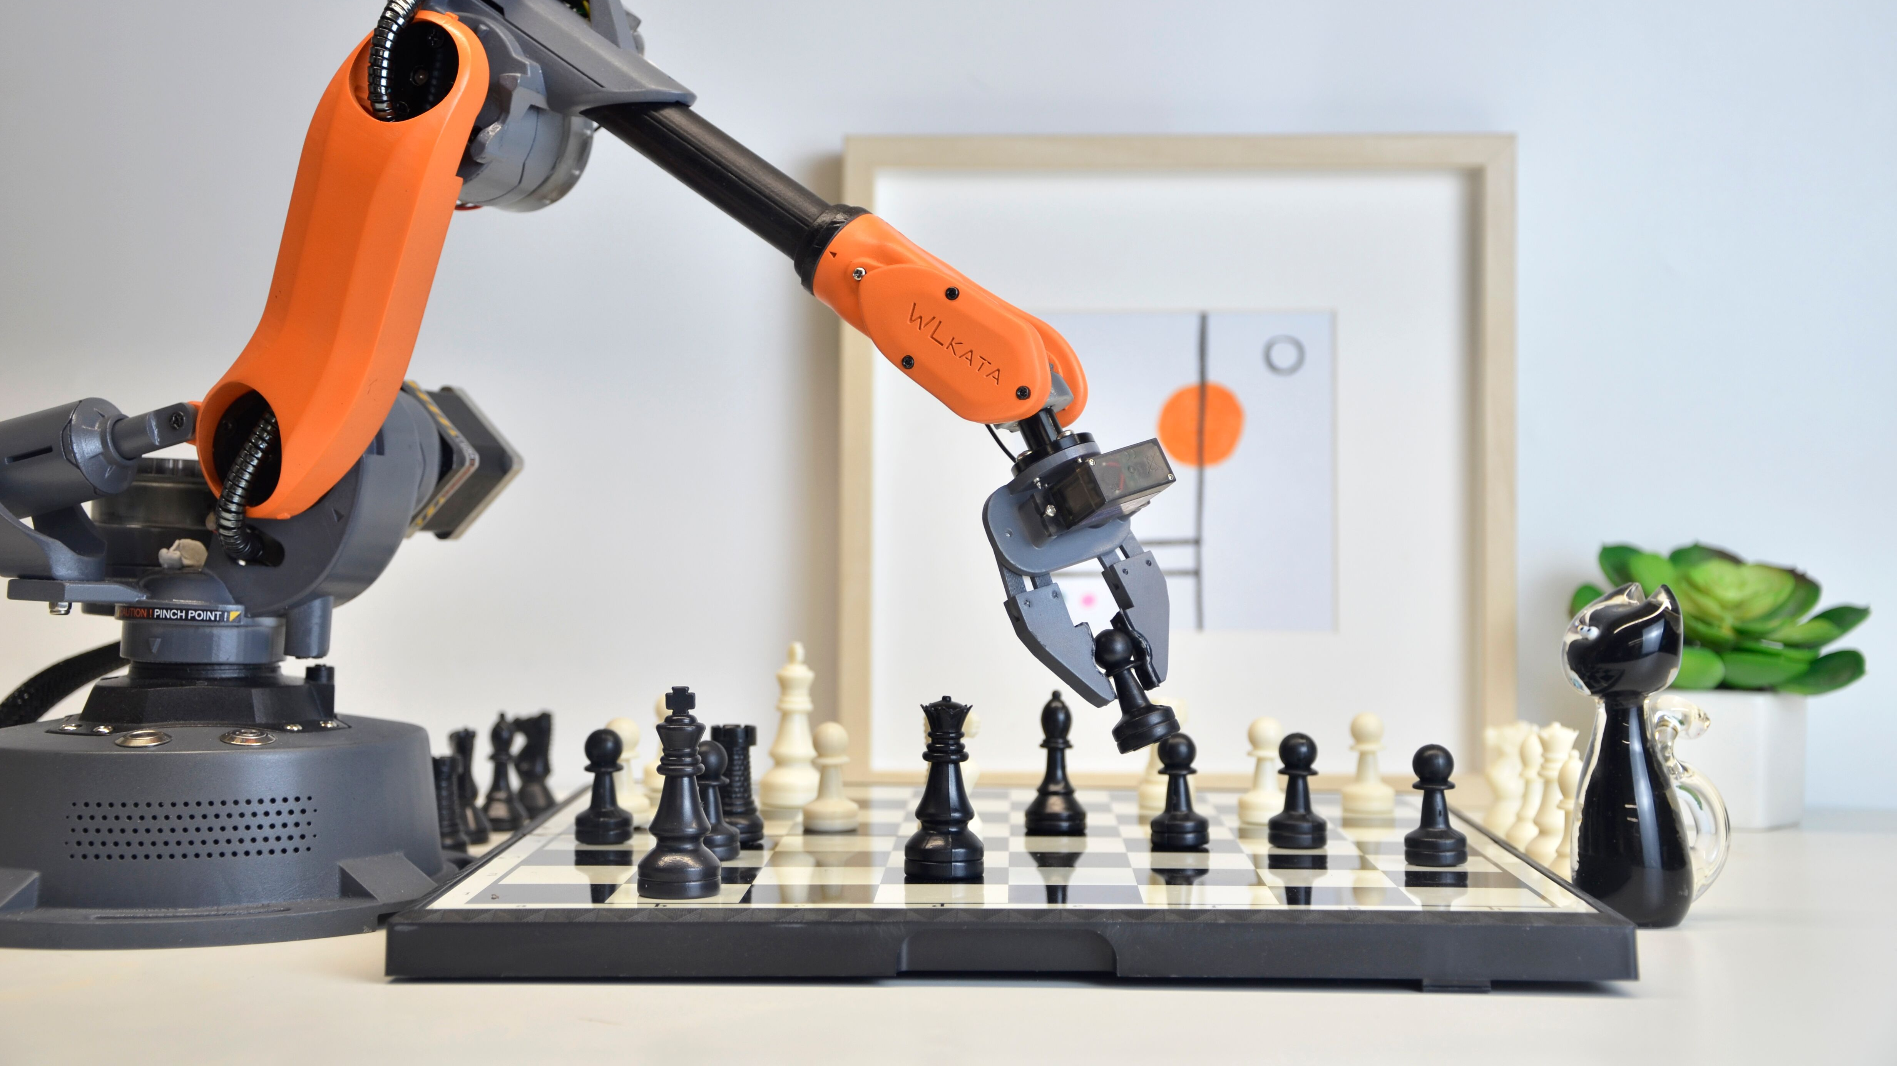
6. Can AIs participate in democratic decision-making?
This Photo by Unknown Author is licensed under CC BY-SA
Notes:
…not merely as ML systems underwriting democratic activity (e.g., via automated systems), but as agents with claims to democratic self-governance?

Slide 45
First, an ambiguity
Q: How, if at all, should AIs participate in democracy?
A: Depends on whether we’re talking about weak AI or strong AI/AGI.
The weak-AI participation in democratic practices: As support for machine learning systems and algorithms supporting democratic procedures (e.g., in voting systems, systems of public information exchange, including digital and social media algorithms, etc.)
The Strong AI/AGI participation: As any autonomous agent of the polis with rights consistent with citizenship?

Slide 46
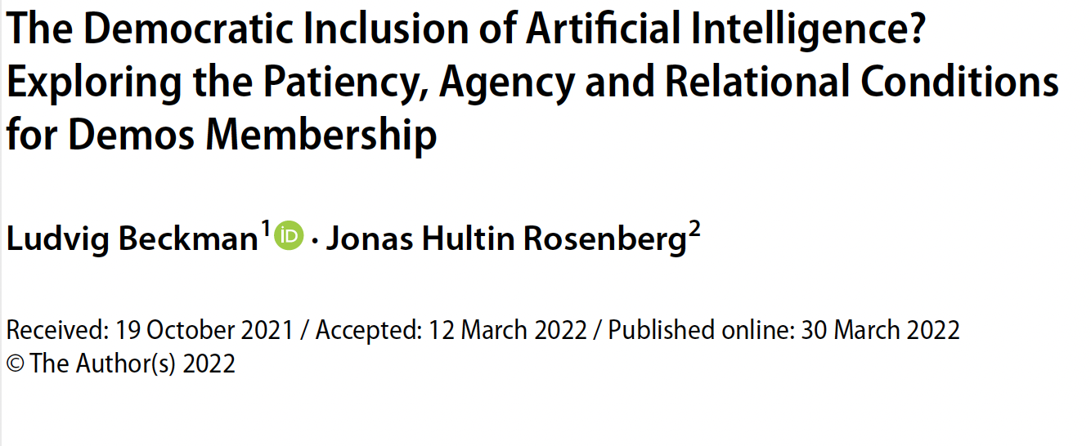
“The Democratic Inclusion of Artificial Intelligence?”
From moral patiency/moral agency to political patience/political agency

Slide 47
Species-ism and the democratic inclusion of AI (AGI/S-AI)
Objection out of the gates: AI are not human, so how can they have the same rights to political participation as humans?
Response: Assume that speciesism is wrong (that all and only humans can qualify for democratic participation just because they are humans).
Question to be addressed: what properties ground right to democratic participation
“Our suggestion is that the properties that future AI needs to possess in order to qualify for democratic inclusion are the properties that an entity needs to possess in order to have political agency and political patiency—i.e. agency and patiency in the sense relevant for democratic inclusion.”

Slide 48
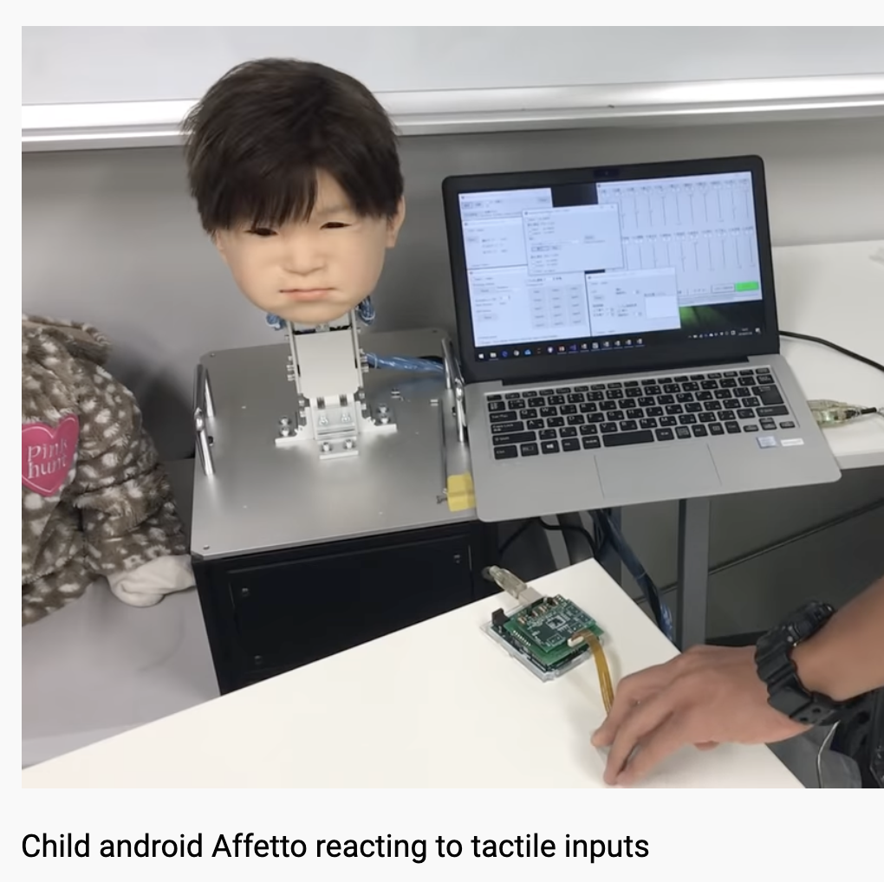
Some issues to be addressed
The (moral and political) rights of technological versus biological beings.
Whether AIs, as designed artefacts, can have intentions separate from those of the designer.
What is required for AIs to be autonomous in the sense required for political participation.
Whether an AGI needs to have affect as well as cognition in order to count morally and be represented politically.
Whether AGIs can experience not just intelligence (cognition) but affect (sensation/emotions)?
Even if S-AI/AGI have moral and legal rights—because it is conscious, autonomous, and intelligent—do these rights extend to the right to political participation?

Slide 49
Can AIs bear the right kind of relationship to the state?
Two competing criteria for democratic inclusion:
AAP: “…an entity is entitled to inclusion in the demos if and only if [it is] affected by the decisions of the political unit in the relevant sense.”
ASP: “…an entity is entitled to inclusion in the demos if and only if [it is] subjected to the decisions of the political unit in the relevant sense.”

Slide 50
Can AIs bear the right kind of relationship to the state?
AAP: “…an entity is entitled to inclusion in the demos if and only if [it is] affected by the decisions of the political unit in the relevant sense.”
Stretches boundary of inclusion to everyone that have interests that can be causally affected by the decisions of the political entity. May includes children, animals, and AI provided they have relevant interests.
Which interests are relevant & does AI have them?
AI plausibly has “teleo interests” (Basl), but this seems too expansive (even bacteria have these)
Limit to interests that require a “sense of self-hood and purposive action”?

Slide 51
Can AIs bear the right kind of relationship to the state?
ASP: “…an entity is entitled to inclusion in the demos if and only if [it is] subjected to the decisions of the political unit in the relevant sense.”
Subjection understood as subjection to law, not just subjection to coercion. Two interpretations:
The first holds that an entity is relevantly subjected to public decisions if and only if the entity is legally obligated to comply with the decision.
- AI can be subject to legal duties only they are the kind of entity that can be the bearer of legal duties (i.e., a legal person) and if it can recognize and respond to rules (i.e., it is the capacity for action)
The second holds that an entity is relevantly subjected to public decision if and only if the entity is subject to claims to legitimate authority.
- Requires agency as well as the capacity to recognize the legitimacy of the law. More stringent than the first.

Slide 52
Does AI have agency in the sense necessary for inclusion on the ASP?
“the first reading of the ASP holds that an entity is subjected to the law in the relevant sense if and only if it is a legal person within the jurisdiction of the legal system: the law applies to legal persons only.”
“the second reading of the ASP, an entity is subjected to the law in the relevant sense if and only if it is a legal person within the jurisdiction of the legal system that possesses the ability to comply with the law and to recognize the law’s claim to legitimate authority.”

Slide 53
Do AIs need to be proper agents for the purposes of democratic inclusion?
Legal personhood - current and future AIs may meet these conditions
Compliance - not all entities that are granted legal personhood (e.g., ecosystems) are capable of complying with the law.
Skepticism: the law is a moving target and not explicitly stated, thus pre-programmed rules won’t work and rigid approaches to problem-solving may similarly fail.
Yet: AI may approach levels of human intuition
Recognition of Appropriate Authority
Does AI have the capacity to recognize the law as legitimate?
Norm-recognition capacity is necessary but not sufficient
Capacity to recognize legitimate authority is a moral capacity
Notes:
“The second is that the capacity to recognize legitimate authority is a moral capacity. The belief that the law has authority is equal to the belief that the powers vested in the legal system are morally legitimate. When subjects believe that law is legitimate, they effectively believe that its directives are morally binding because they believe that the law provides reasons that apply to them independently (Raz, 1986).

Slide 54
Upshot for ASP
“With respect to AI, the implication is that they should be included in the demos only if they have the ability to make moral judgments about the legitimacy of legal authority.”

Slide 55
Moral and political patiency
AAP: Political patiency = an entity has interests that warrant its political inclusion (not the same as having interests that deserve political protection)
Which interests matter? Psychological interests (not merely teleo interests)
Autonomy
Kantian view collapses moral agency with moral patiency
Autonomy as life plans (but implications for children and severely cognitively limited adults)
Consciousness (as subjective experience)
Inclusion limited at sentience, but broadly inclusive

Slide 56
Summary
“AI’s can be either affected or subjected to collective decisions. But … it is less clear that AI’s do or can satisfy agency and patiency requirements. Democratic inclusion cannot be conclusively determined from the fact that an entity is either subjected or affected by public decisions: only agents and/or patients qualify as members of the demos.”

Slide 57

Exercises

Slide 58
Thank you!
This Photo by Unknown Author is licensed under CC BY-ND

Slide 59

Here are some extras, Dave.
This Photo by Unknown Author is licensed under CC BY-SA-NC

Slide 60

5. Case Studies in Ethical AI
Exercises through the lens of the five principles
This Photo by Unknown Author is licensed under CC BY-NC

Slide 61
Applying the Five Bioethical Principles further
Floridi et al. focus on making recommendations based on the 5 principles to governments, but what about other stakeholders? Turn to case studies.
As we consider the case study questions:
… consider how your answers draw on the five bioethical principles:
Beneficence – non-maleficence – autonomy – justice – explicability

Slide 62

Case Study A: Law Enforcement Chatbots
Case Studies are the product of the Princeton University Center for Human Values (UCHV) and the Center for Information Technology Policy (CITP) at Princeton. http://www.aiethics.princeton.edu
This Photo by Unknown Author is licensed under CC BY-SA

Slide 63

Case Study B : Optimizing Schools
Case Studies are the product of the Princeton University Center for Human Values (UCHV) and the Center for Information Technology Policy (CITP) at Princeton. http://www.aiethics.princeton.edu

Slide 64

Case Study C: Automated Healthcare App
Case Studies are the product of the Princeton University Center for Human Values (UCHV) and the Center for Information Technology Policy (CITP) at Princeton. http://www.aiethics.princeton.edu
This Photo by Unknown Author is licensed under CC BY-ND

Slide 65
AI & valuable institutions
AI & the maintenance or erosion of democratic norms
Privacy concerns (e.g., facial recognition technologies, collection of private data)
Human agency (nudging, opaque algorithms)
Limiting human deliberative capacities (driving people into siloes; amplifying tribalistic beliefs; corroding trust in trustworthy institutions and individuals).

Slide 66
Assessment
1. Assess the capacity of existing institutions, such as national civil courts, to redress the mistakes made or harms inflicted by AI systems.
2. Assess which tasks and decision-making functionalities should not be delegated to AI systems, through the use of participatory mechanisms to ensure alignment with societal values and understanding of public opinion.
3. Assess whether current regulations are sufficiently grounded in ethics to provide a legislative framework that can keep pace with technological developments.
Notes:
Assessment
1. Assess the capacity of existing institutions, such as national civil courts, to redress
the mistakes made or harms inflicted by AI systems. This assessment should
evaluate the presence of sustainable, majority-agreed foundations for liability
from the design stage onwards, in order to reduce negligence and conflicts (see
also Recommendation 5).6
2. Assess which tasks and decision-making functionalities should not be delegated to
AI systems, through the use of participatory mechanisms to ensure alignment with societal values and understanding of public opinion.
all stakeholders (including government, industry, and civil society) to debate how
AI will impact society opinion (in concert with Recommendation 17).
3. Assess whether current regulations are sufficiently grounded in ethics to provide a
legislative framework that can keep pace with technological developments. This
may include a framework of key principles that would be applicable to urgent
and/or unanticipated problems.

Slide 67
Development
4. Develop a framework to enhance the explicability of AI systems that make socially significant decisions.
5. Develop appropriate legal procedures and improve the IT infrastructure of the justice system to permit the scrutiny of algorithmic decisions in court.
6. Develop auditing mechanisms for AI systems to identify unwanted consequences, such as unfair bias, and (for instance, in cooperation with the insurance sector) a solidarity mechanism to deal with severe risks in AI-intensive sectors.
7. Develop agreed-upon metrics for the trustworthiness of AI products and services, to be undertaken either by a new organisation, or by a suitable existing organisation. “Trust index”
Notes:
4. Develop a framework to enhance the explicability of AI systems that make
socially significant decisions.
5. Develop appropriate legal procedures and improve the IT infrastructure of the
justice system to permit the scrutiny of algorithmic decisions in court.
6. Develop auditing mechanisms for AI systems to identify unwanted consequences,
such as unfair bias, and (for instance, in cooperation with the insurance sector)
a solidarity mechanism to deal with severe risks in AI-intensive sectors.
7. Develop agreed-upon metrics for the trustworthiness of AI products and services,
to be undertaken either by a new organisation, or by a suitable existing
organisation. “Trust index”

Slide 68
Incentivisation (a few items from the list)
12. Incentivise financially … the development and use of AI technologies … that are socially preferable (not merely acceptable) and environmentally friendly (not merely sustainable but favourable to the environment).
13. Incentivise financially a sustained, increased and coherent … research effort, tailored to the specific features of AI as a scientific field of investigation.
14. Incentivise financially cross-disciplinary and cross-sectoral cooperation and debate concerning the intersections between technology, social issues, legal studies, and ethics.
Notes:
12. Incentivise financially, at the EU level, the development and use of AI technologies
within the EU that are socially preferable (not merely acceptable) and
environmentally friendly (not merely sustainable but favourable to the environment).
This will include the elaboration of methodologies that can help assess
whether AI projects are socially preferable and environmentally friendly. In this
vein, adopting a ‘challenge approach’ (see DARPA challenges) may encourage
creativity and promote competition in the development of specific AI solutions
that are ethically sound and in the interest of the common good.
13. Incentivise financially a sustained, increased and coherent European research
effort, tailored to the specific features of AI as a scientific field of investigation.
This should involve a clear mission to advance AI for social good, to serve as a
unique counterbalance to AI trends with less focus on social opportunities.
14. Incentivise financially cross-disciplinary and cross-sectoral cooperation and
debate concerning the intersections between technology, social issues, legal
studies, and ethics. Debates about technological challenges may lag behind the
actual technical progress, but if they are strategically informed by a diverse,
multistakeholder group, they may steer and support technological innovation in
the right direction. Ethics should help seize opportunities and cope with challenges,
not only describe them. It is essential in this respect that diversity infuses
the design and development of AI, in terms of gender, class, ethnicity, discipline
and other pertinent dimensions, in order to increase inclusivity, toleration, and
the richness of ideas and perspectives.
15. Incentivise financially the inclusion of ethical, legal and social considerations
in AI research projects. In parallel, incentivise regular reviews of legislation to
test the extent to which it fosters socially

Slide 69
Support
18. Support the development of self-regulatory codes of conduct for data and AI related professions, with specific ethical duties.
19. Support the capacity of corporate boards of directors to take responsibility for the ethical implications of companies’ AI technologies.
20. Support the creation of educational curricula and public awareness activities around the societal, legal, and ethical impact of Artificial Intelligence.
Notes:
Support the development of self-regulatory codes of conduct for data and AI
related professions, with specific ethical duties. This would be along the lines
of other socially sensitive professions, such as medical doctors or lawyers, i.e.,
with the attendant certification of ‘ethical AI’ through trust-labels to make sure
that people understand the merits of ethical AI and will therefore demand it
from providers. Current attention manipulation techniques may be constrained
through these self-regulating instruments.
19. Support the capacity of corporate boards of directors to take responsibility for
the ethical implications of companies’ AI technologies. For example, this may
include improved training for existing boards and the potential development
of an ethics committee with internal auditing powers. This could be developed
within the existing structure of both one-tier and two-tier board systems, and/or
in conjunction with the development of a mandatory form of “corporate ethical
review board” to be adopted by organisations developing or using AI systems,
to evaluate initial projects and their deployment with respect to fundamental
principles.
20. Support the creation of educational curricula and public awareness activities
around the societal, legal, and ethical impact of Artificial Intelligence.

Slide 70
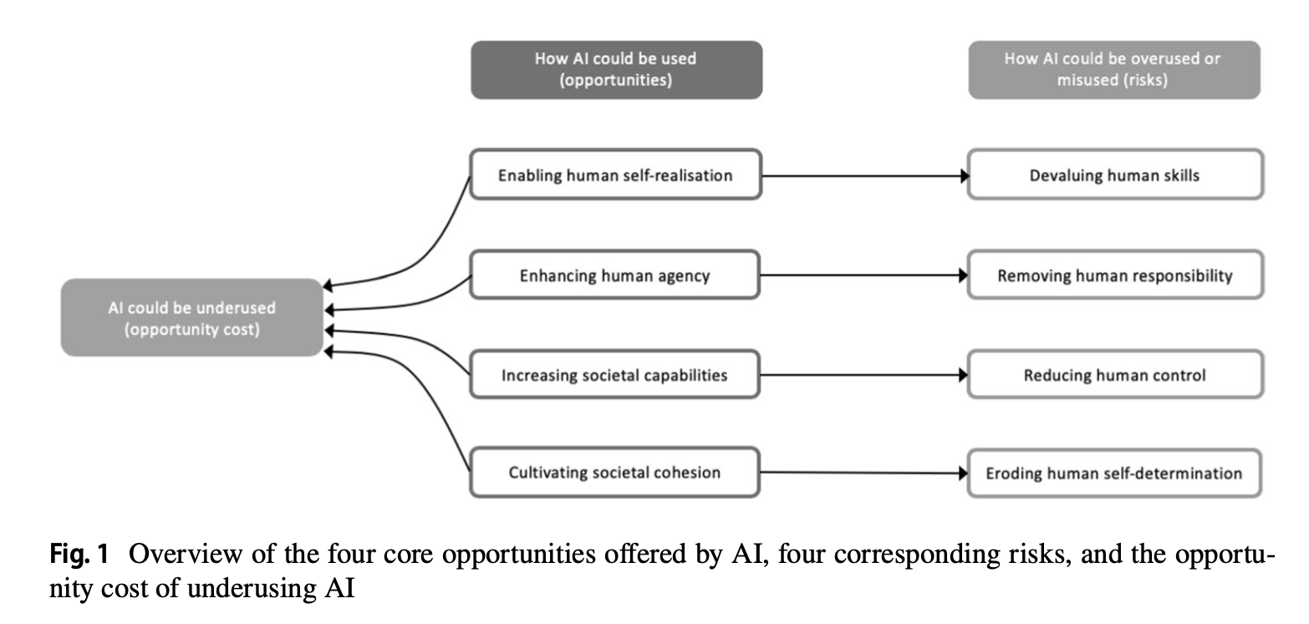
Risks and Opportunities
(Floridi et al 2018, 691)
Notes:
“we introduce here what we consider the four chief opportunities for society that AI offers. They are four because they address the four fundamental points in the understanding of human dignity and flourishing:
who we can become (autonomous self-realisation);
free people up for more valuable projects, but caution against devaluing skills that matter to individuals’ sense of self or eliminating sources of income too quickly
what we can do (human agency);
could “amplify and strengthen shared moral systems”
what we can achieve (individual and societal capabilities);
can enhance medical diagnoses, enhance complex systems like air travel systems, etc. But risk of delegating too much,
and how we can interact with each other and the world (societal cohesion).
can solve complex coordination problems that threaten societies (climate change, nuclear proliferation, etc). But must be the result of “self-imposed choice” so as to preserve our autonomy.
In each case, AI can be used to foster human nature and its potentialities, thus creating opportunities;
underused, thus creating opportunity costs; (“It might include, for example, heavy-handed or misconceived regulation, under-investment, or a public backlash akin to that faced by genetically modified crops”)
or overused and misused, thus creating risks.” (from spam to cyber warfare – usually malicious, misaligned incentives, greed, etc.)

Slide 71
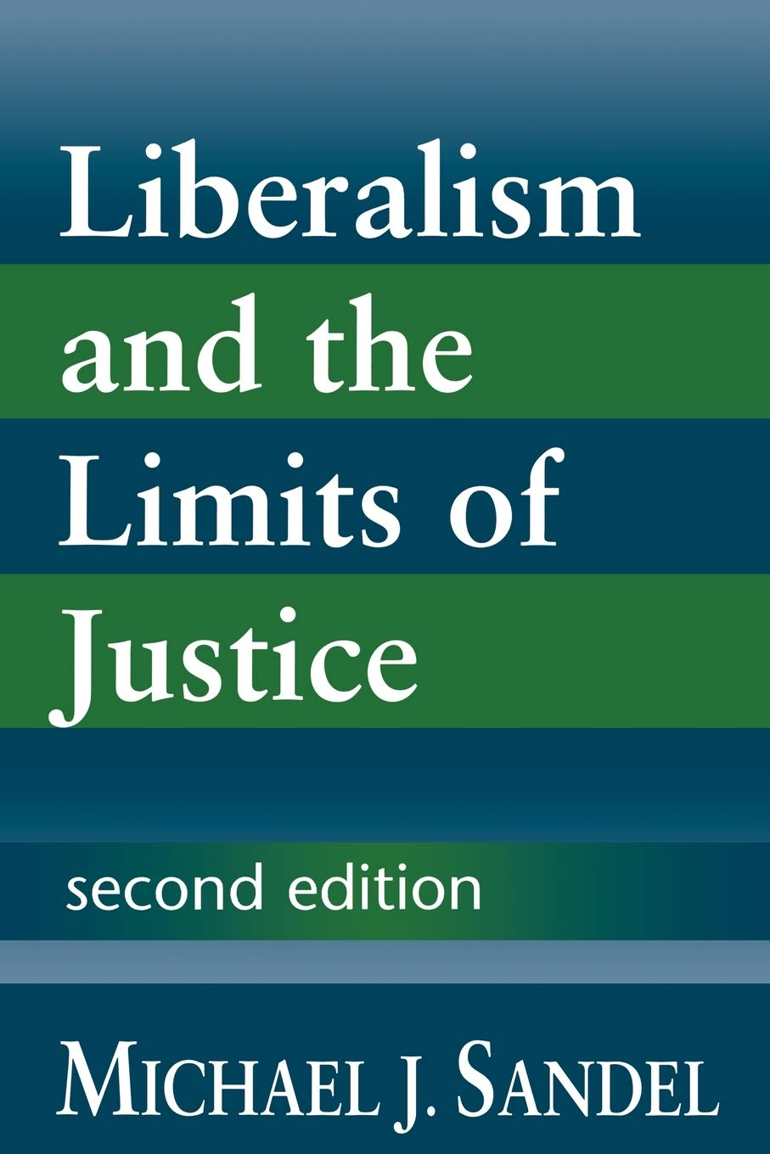


AI and Justice
Kinds of justice – e.g., distributive justice (v corrective), retributive justice, corrective, procedural (v substantive) , ideal V nonideal, justice as a personal virtue, etc.
Substantive accounts of justice vary – depends in part on commitments to moral-political frameworks, such as liberal, liberal-egalitarian, communitarian, etc. conceptions of justice)
Justice and AI might include concerns about:
How AI risks perpetuating discriminatory practices, e.g., by encoding racist, sexist, and other immoral biases
Whether people have fair access to AI-generated goods
Whether AI might destabilize valuable social structures & institutions (e.g., by driving misinformation, polarization, and extremism) and whether these can be countered with AI
Notes:
Procedural v substantive: A third distinction that must be drawn is between the justice of the procedures that might be used to determine how benefits and burdens of various kinds are allocated to people, and the justice of the final allocation itself. (SEP)
Corrective V distributive: A second important contrast, whose pedigree reaches back at least as far as Aristotle, is between justice as a principle for assigning distributable goods of various kinds to individual people, and justice as a remedial principle that applies when one person wrongly interferes with another’s legitimate holdings. (SEP)

